Slide 1
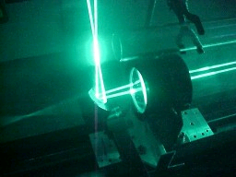
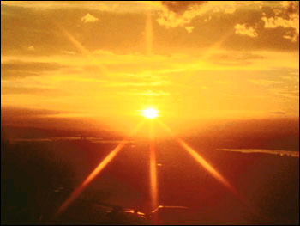
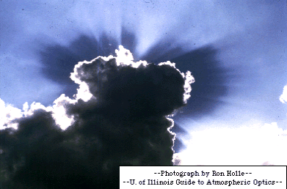
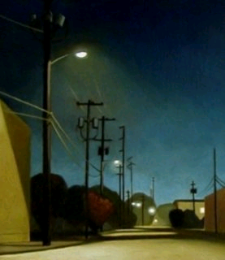
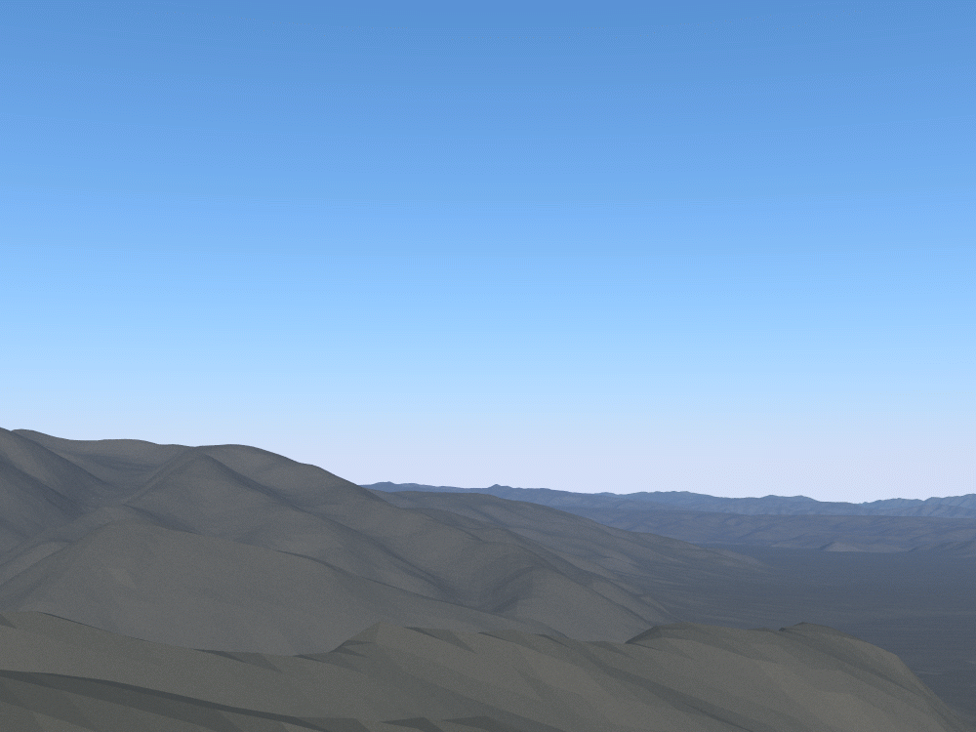

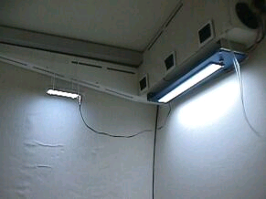
Advanced 3D computer graphics for movies and games (NPGR010)
– Light reflection, BRDF
Jiří Vorba, MFF UK/Weta Digital
jirka@cgg.mff.cuni.cz
Slides of prof. Jaroslav Křivánek, minor edits by Jiří Vorba

Slide 2
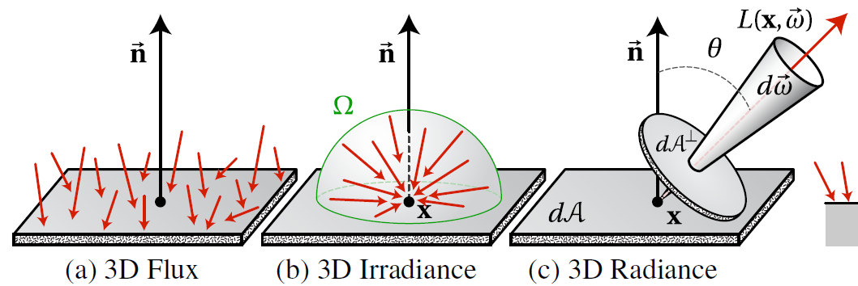
Recap – Basic radiometric quantities
Image: Wojciech Jarosz

Slide 3
Interaction of light with a surface
Absorption
Reflection
Transmission / refraction
Reflective properties of materials determine
  the relation of reflected radiance L_{r} to incoming radiance L_{i} , and therefore
  the appearance of the object: color, glossiness, etc.

Slide 4
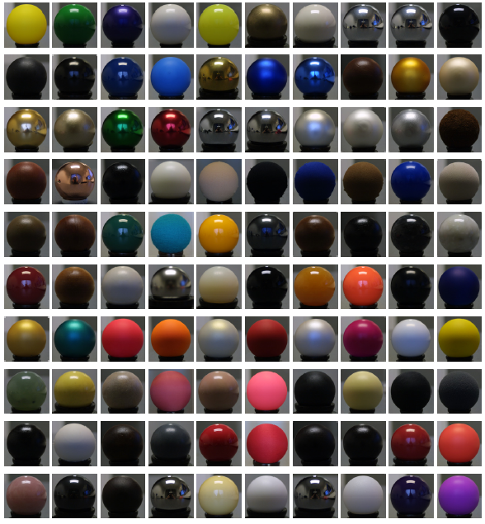
Interaction of light with a surface
Same illumination
Different materials
Source: MERL BRDF database

Slide 5
Recall the Phong shading model
N
R
L
V

Slide 6
I) Adopt radiometric notation
n
r
θ_{i}
ω_{i}
θ_{r}
ω_{o}
Exact same thing as on the previous slide – just using physically-based notation.

Slide 7
BRDF corresponding to the original Phong shading model
n
θ_{i}
r
ω_{i}
θ_{r}
ω_{o}
BRDF:
General definition of a BRDF
Application of this definition to the
Phong shading formula.

Slide 8
BRDF – Formal definition
Bidirectional Reflectance Distribution Function
„outgoing“
n
L_{i}(ω_{i})
L_{r}(ω_{o})
dω_{i}
θ_{o}
θ_{i}
„incoming“
„reflected“

Slide 9
BRDF
Mathematical model of the reflection properties of a surface
Intuition
  Value of a BRDF = probability density, describing the event that a light energy “packet”, or “photon”, coming from direction ω_{i} gets reflected to the direction ω_{o}.
Range:

Slide 10
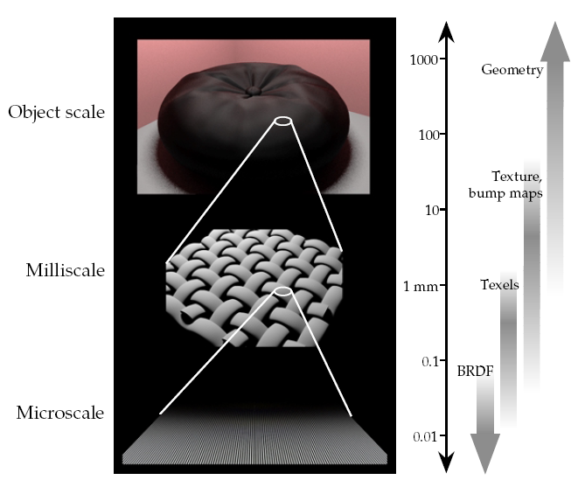
BRDF
The BRDF is a model of the bulk behavior of light on the microstructure when viewed from distance
Westin et al. Predicting Reflectance Functions from Complex Surfaces, SIGGRAPH 1992.

Slide 11
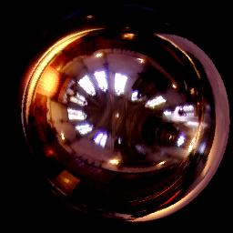
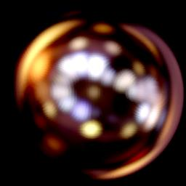
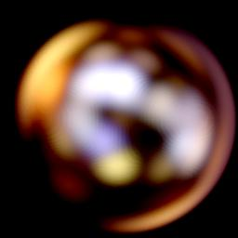
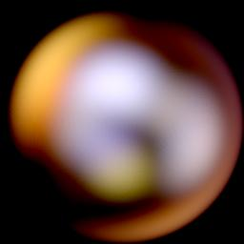
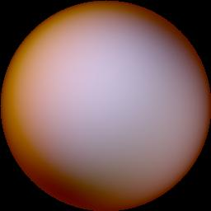
Surface roughness and blurred reflections
The rougher the blurrier
Microscopic surface roughness

Slide 12
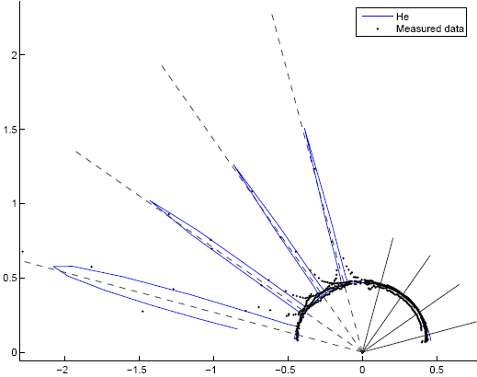
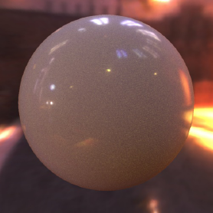
Surface appearance and the BRDF
Appearance
BRDF lobe
(for four different viewing directions)
Souce: Ngan et al. Experimental analysis of BRDF models, http://people.csail.mit.edu/addy/research/brdf/

Slide 13
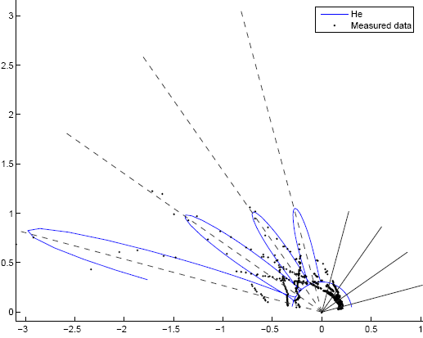
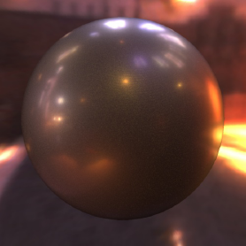
Surface appearance and the BRDF
Appearance
BRDF lobe
(for four different viewing directions)
Souce: Ngan et al. Experimental analysis of BRDF models, http://people.csail.mit.edu/addy/research/brdf/

Slide 14
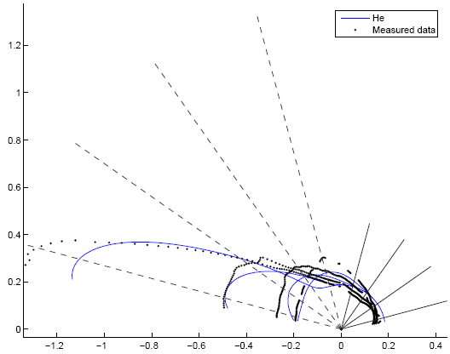
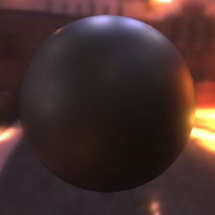
Surface appearance and the BRDF
Appearance
BRDF lobe
(for four different viewing directions)
Souce: Ngan et al. Experimental analysis of BRDF models, http://people.csail.mit.edu/addy/research/brdf/

Slide 15
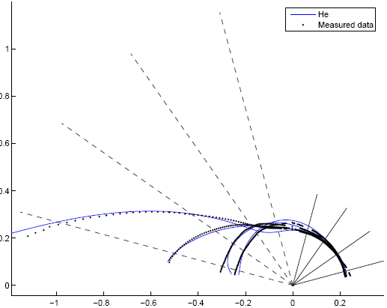
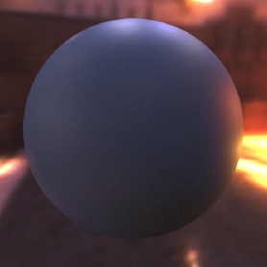
Surface appearance and the BRDF
Appearance
BRDF lobe
(for four different viewing directions)
Souce: Ngan et al. Experimental analysis of BRDF models, http://people.csail.mit.edu/addy/research/brdf/

Slide 16
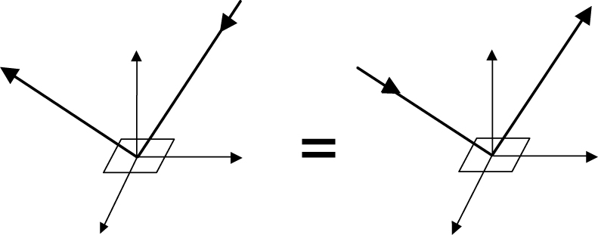
BRDF properties
Helmholz reciprocity (always holds in nature, a physically-plausible BRDF model must follow it)

Slide 17
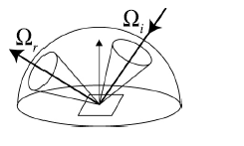
BRDF properties
Energy conservation
  A patch of surface cannot reflect more light energy than it receives

Slide 18
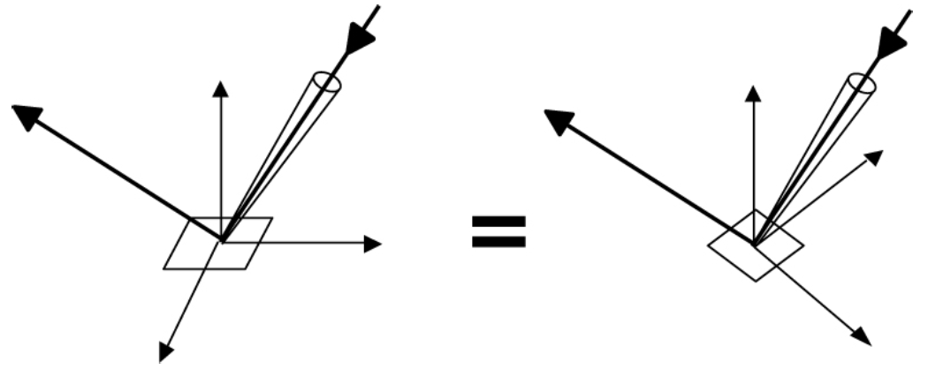
BRDF (an)isotropy
Isotropic BRDF = invariant to a rotation around surface normal

Slide 19
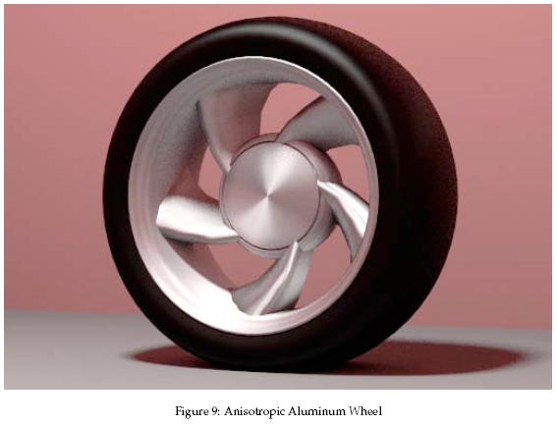
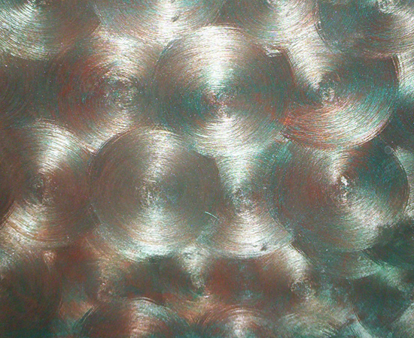
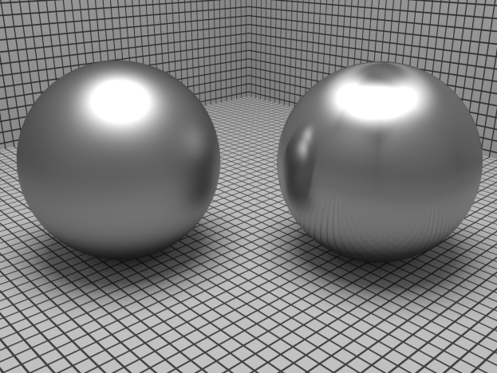
Surfaces with anisotropic BRDF

Slide 20
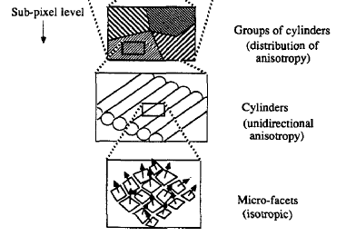
Anisotropic BRDF
Different microscopic roughness in different directions (brushed metals, fabrics, …)

Slide 21
Isotropic vs. anisotropic BRDF
Isotropic BRDFs have only 3 degrees of freedom
  Instead of φ_{i} and φ_{o} it is enough to consider only Δφ = φ_{i} – φ_{o}
  But this is not enough to describe an anisotropic BRDF
Description of an anisotropic BRDF
  φ_{i} and φ_{o} are expressed in a local coordinate frame
  (U, V, N)
    U … tangent – e.g. the direction of brushing
    V … binormal
    N … surface normal … the Z axis of the local coordinate frame

Slide 22
Reflection equation
A.k.a. reflectance equation, illumination integral, OVTIGRE (“outgoing, vacuum, time-invariant, gray radiance equation”)
“How much total light gets reflected in the direction ω_{o}?“
From the definition of the BRDF, we have

Slide 23
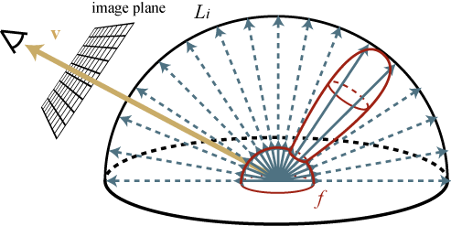
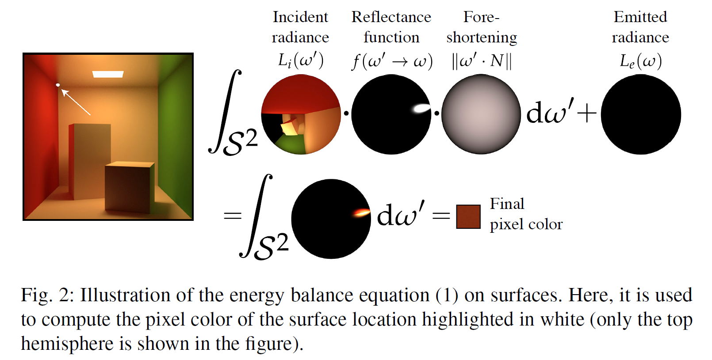

Reflection equation
Total reflected radiance: integrate contributions of incident radiance, weighted by the BRDF, over the hemisphere
upper hemisphere over x
$$=\int{}$$

Slide 24
Reflection equation
Evaluating the reflectance equation renders images!!!
  Direct illumination
    Environment maps
    Area light sources
    etc.

Slide 25
Energy conservation – More rigorous
Reflected flux per unit area (i.e. radiosity B) cannot be larger than the incoming flux per unit surface area (i.e. irradiance E).

Slide 26
Reflectance
Ratio of the incoming and outgoing flux
  A.k.a. „albedo“ (used mostly for diffuse reflection)
Hemispherical-hemispherical reflectance
  See the “Energy conservation” slide
Hemispherical-directional reflectance
  The amount of light that gets reflected in direction ω_{o} when illuminated by the unit, uniform incoming radiance.

Slide 27
Hemispherical-directional reflectance
Nonnegative
Less than or equal to 1
(energy conservation)
Equal to directional-hemispherical reflectance
  What is the percentage of the energy coming from the incoming direction ω_{i} that gets reflected (to any direction)?“
  Equality follows from the Helmholz reciprocity

Slide 28
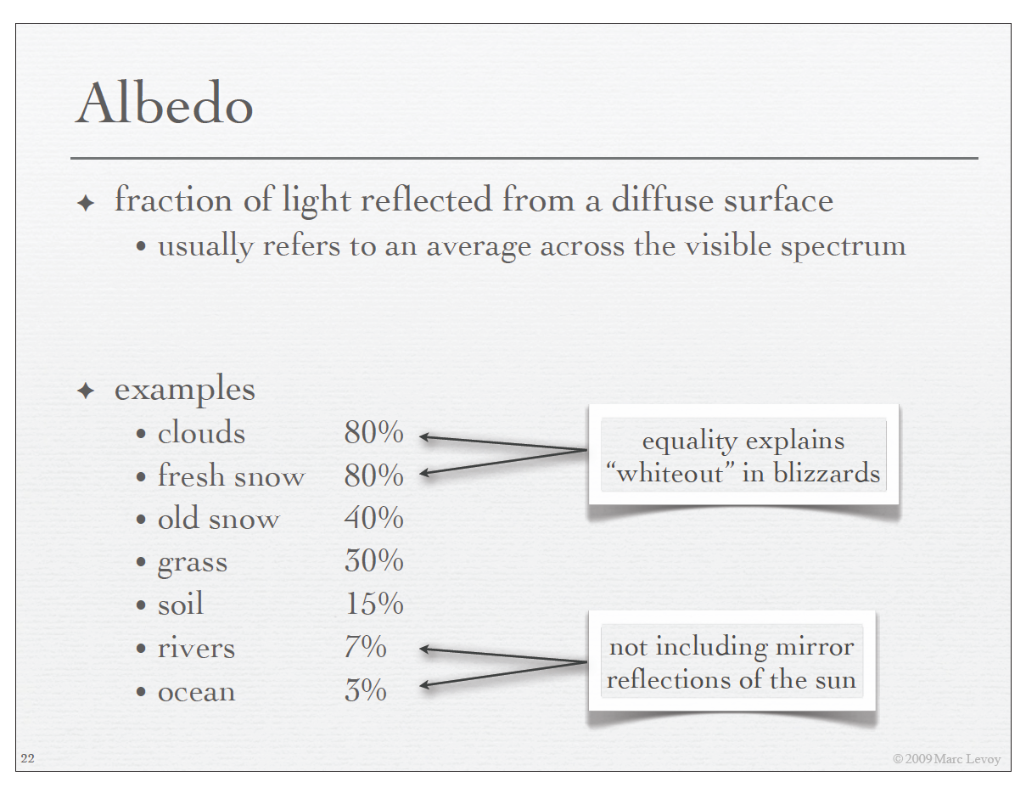

Slide 29
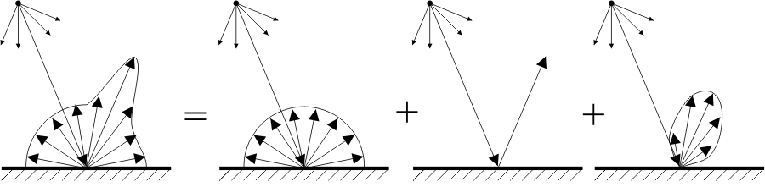
BRDF components
General BRDF
Ideal diffuse
(Lambertian)
Ideal specular
Glossy,
directional
diffuse

Slide 30
Ideal diffuse reflection

Slide 31
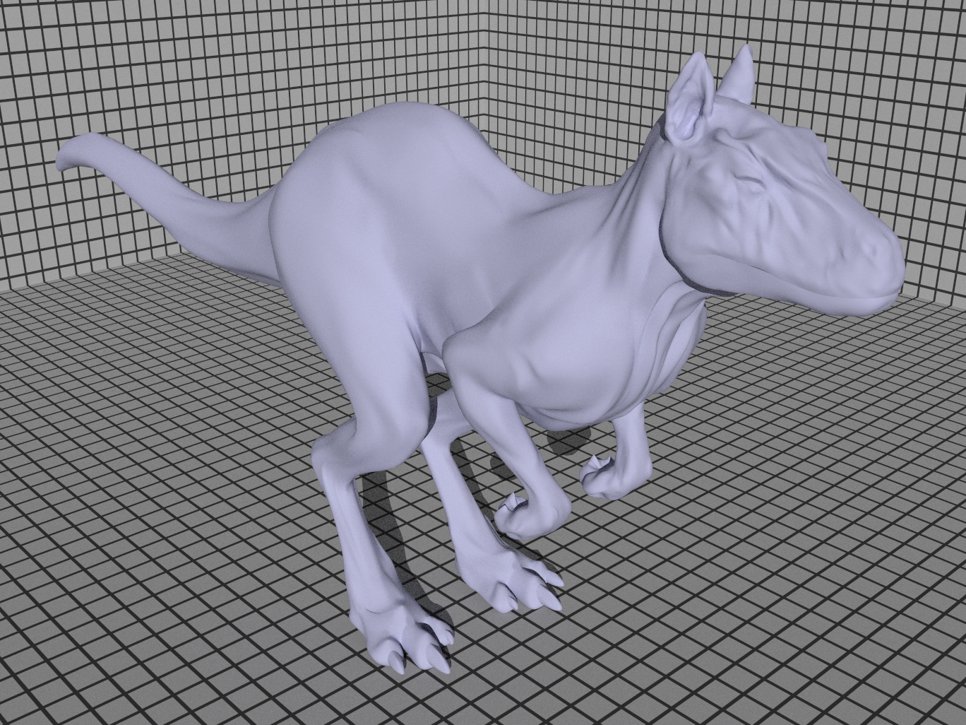
Ideal diffuse reflection

Slide 32
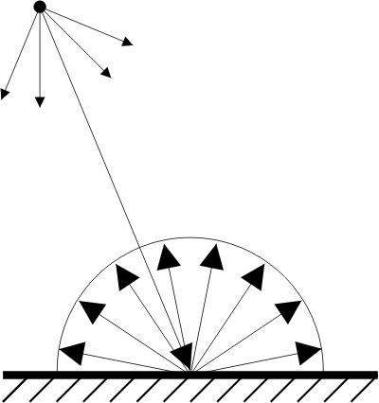
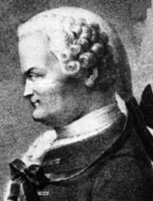
Ideal diffuse reflection
A.k.a. Lambertian reflection
  Johann Heinrich Lambert, „Photometria“, 1760.
Postulate: Light gets reflected to all directions with the same probability, irrespective of the direction it came from
The corresponding BRDF is a constant function (independent of ω_{i} , ω_{o})

Slide 33
Ideal diffuse reflection
Reflection on a Lambertian surface:
View independent appearance
  Outgoing radiance L_{o} is independent of ω_{o}
Reflectance (derive)
irradiance

Slide 34
Ideal diffuse reflection
Mathematical idealization that does not exist in nature
The actual behavior of natural materials deviates from the Lambertian assumption especially for grazing incidence angles

Slide 35
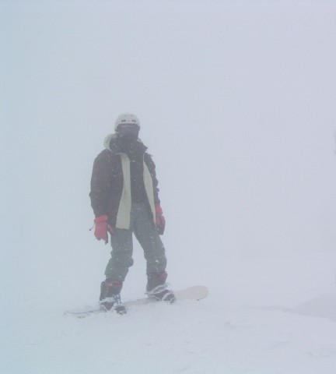
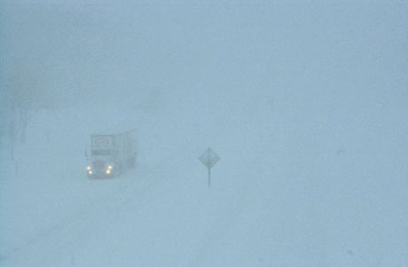
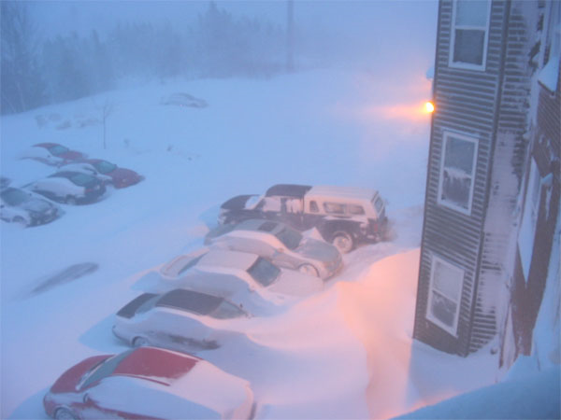
White-out conditions
Under a covered sky we cannot tell the shape of a terrain covered by snow
We do not have this problem
close to a localized light source.
Why?

Slide 36
White-out conditions
We assume sky radiance independent of direction
(covered sky)
We also assume Lambertian reflection on snow
Reflected radiance given by:
White-out!!!

Slide 37
Ideal mirror reflection

Slide 38
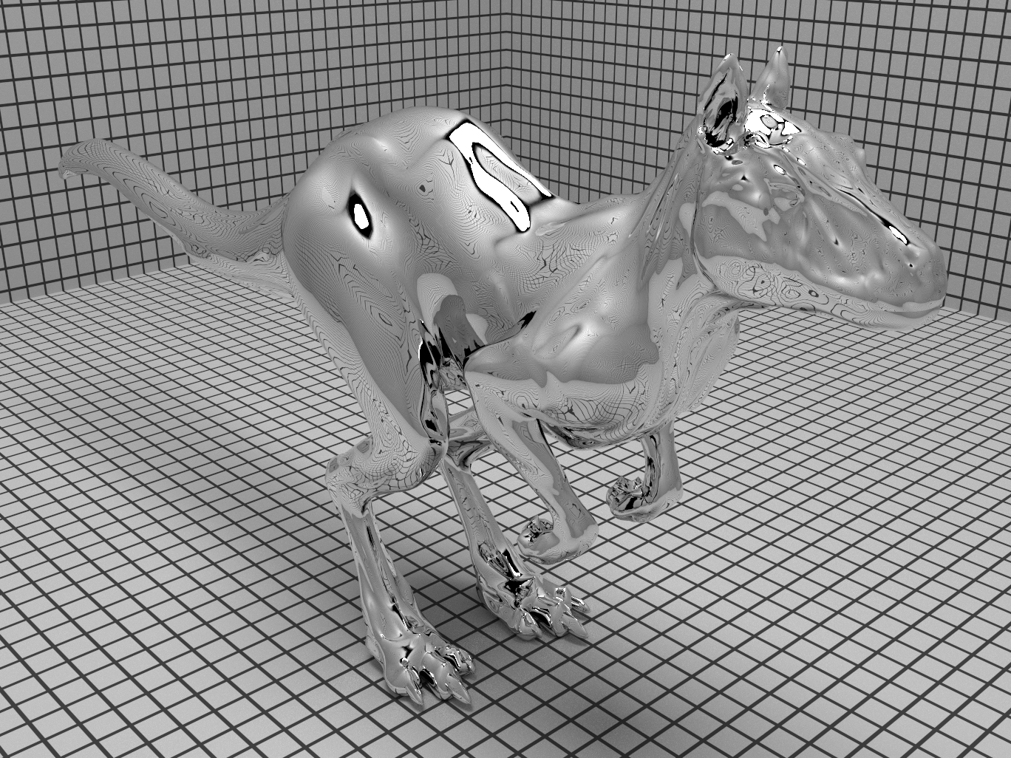
Ideal mirror reflection

Slide 39
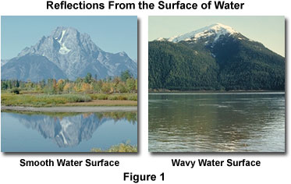

Slide 40
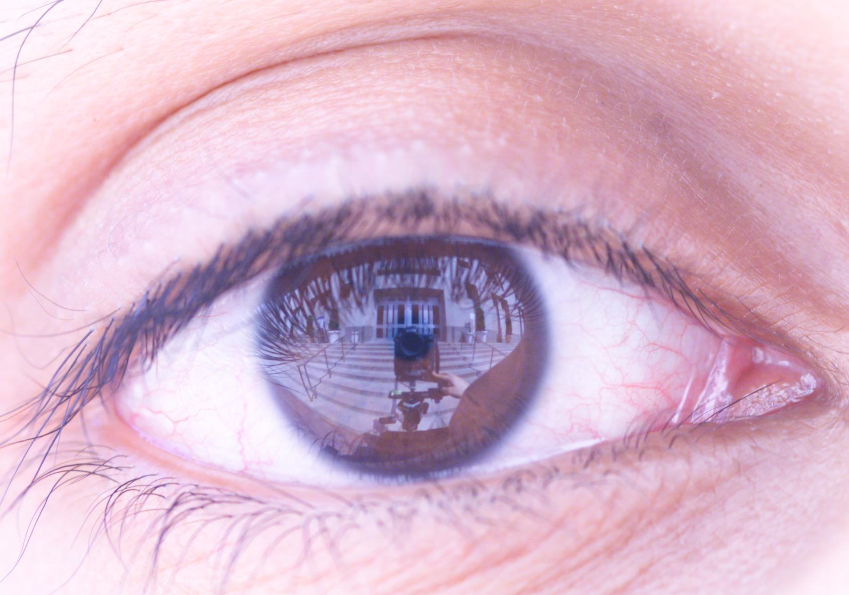
Nishino, Nayar: Eyes for Relighting, SIGGRAPH 2004

Slide 41
The law of reflection
n
  Direction of the reflected ray (derive the formula)
φ_{o}
θ_{o}
θ_{i}
φ_{i}
θ_{o} = θ_{i}
φ_{o} = (φ_{i} + π) mod 2π

Slide 42
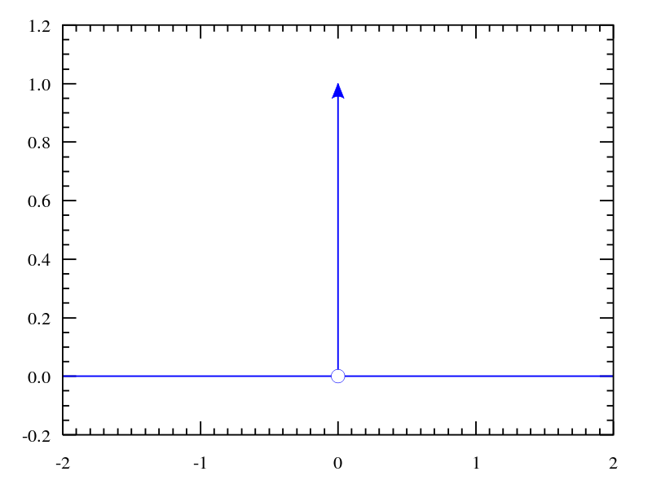



Digression: Dirac delta distribution
Definition (informal):
The following holds for any f:
Delta distribution is not a function (otherwise the integrals would = 0)
Image: Wikipedia

Slide 43
BRDF of the ideal mirror
BRDF of the ideal mirror is a Dirac delta distribution
n
We want:
θ_{o} = θ_{i}
θ_{o}
θ_{i}
Fresnel reflectance (see below)

Slide 44
BRDF of the ideal mirror
BRDF of the ideal mirror is a Dirac delta distribution
Verification:

Slide 45


Slide 46
Ideal refraction

Slide 47
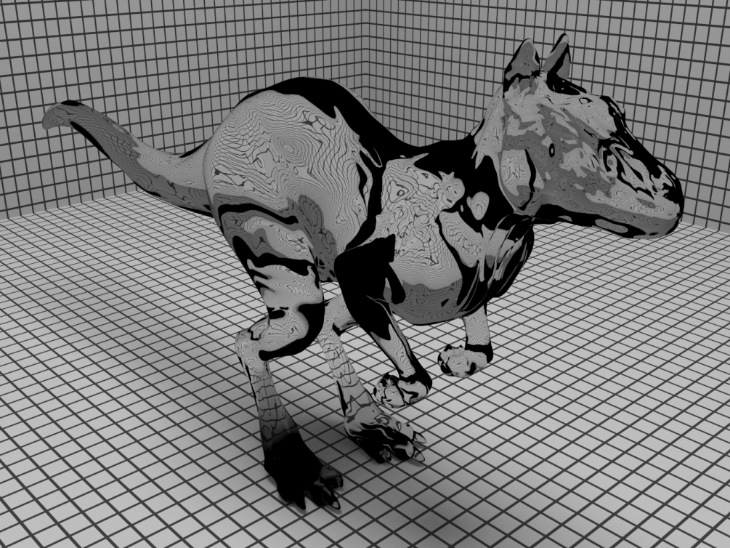
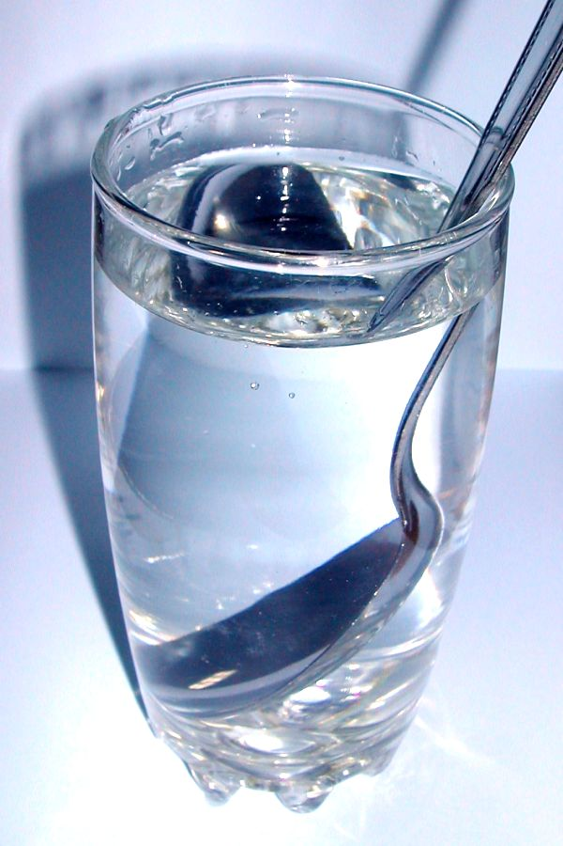
Ideal refraction

Slide 48
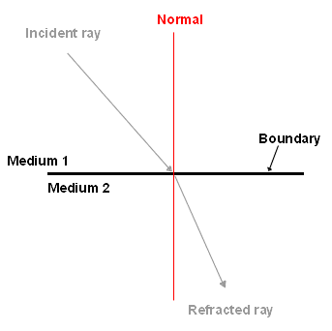
Ideal refraction
Index of refraction η
  “change of light speed”
  Water 1.33, glass 1.6, diamond 2.4
  Often depends on the wavelength
Snell’s law
ω_{i}
η_{i}
η_{o}
ω_{o}

Slide 49
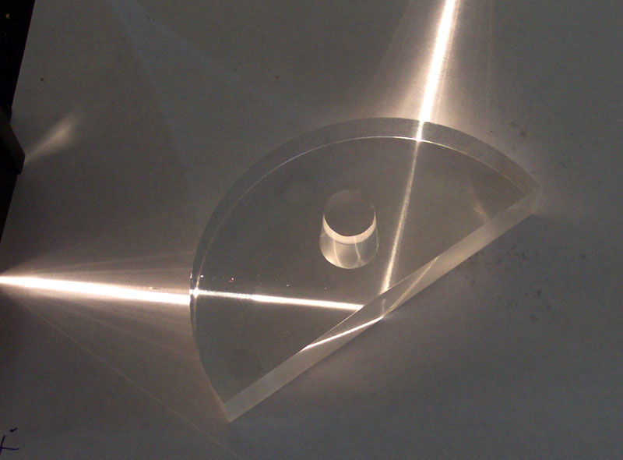
Ideal refraction
Direction of the refracted ray:
if < 0, total internal reflection
Critical angle:
Image: wikipedia

Slide 50
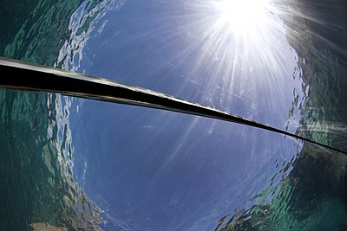
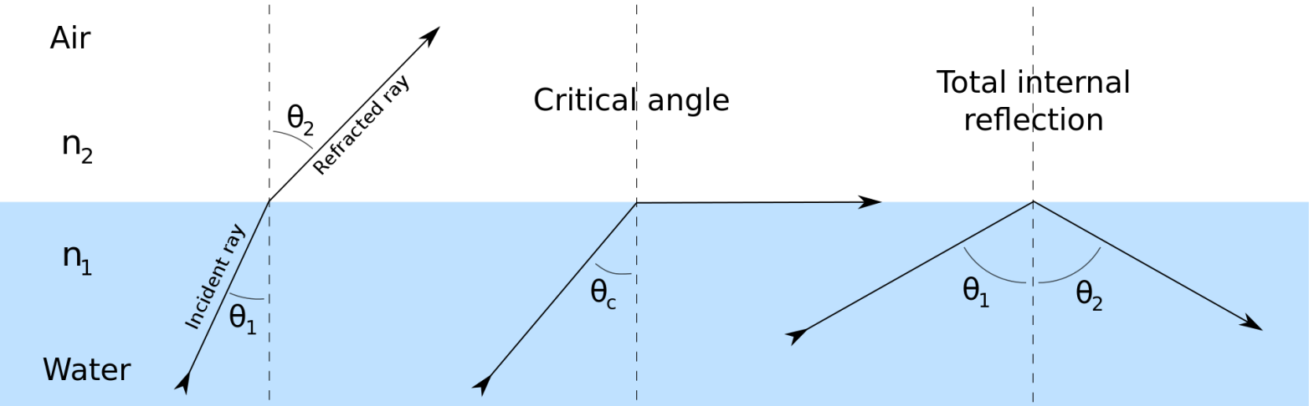
Snell’s window
View straight up from underwater. The above-water hemisphere is visible, compressed (as by a circular fisheye lens) into a circle (Snell's window) bounded by the critical angle. Everything outside the critical-angle circle is reflected from below the water.
https://en.wikipedia.org/wiki/Snell%27s_window
Notes:
View straight up from underwater. The above-water hemisphere is visible, compressed (as by a circular fisheye lens) into a circle (Snell's window) bounded by the critical angle. Everything outside the critical-angle circle is reflected from below the water.

Slide 51


Snell’s window
A diver viewed from below who appears inside of Snell's window.
The edge of Snell's window, in this case the boundary between reflected bottom (teal) and refracted sky and above-water structures (blue and gray)
https://en.wikipedia.org/wiki/Snell%27s_window

Slide 52
Ideal refraction
Change of radiance
  Follows from the conservation of energy (flux)
  When going from an optically rarer to a denser medium, light energy gets “compressed” in directions => higher energy density => higher radiance

Slide 53
BRDF of ideal refraction
BRDF of the ideal refraction is a delta distribution:
Fresnel transmittance
Change of radiance
Snell’s law
Refracted ray stays in the incidence plane

Slide 54
Fresnel equations

Slide 55



Fresnel equations
Read [frenel]
Ratio of the transmitted and reflected light depends on the incident direction
  From above – more transmission
  From the side – more reflection
Extremely important for realistic rendering of glass, water and other smooth dielectrics
Not to be confused with
Fresnel lenses
(used in lighthouses)

Slide 56
Fresnel equations
From the side
- little transmission
- more reflection
From above
- little reflection
- more transmission
Try for yourself!!!

Slide 57




Fresnel equations
Dielectrics
Image: Wikipedia

Slide 58

Fresnel equations
Dielectrics

Slide 59

Fresnel equations
Metals

Slide 60
More on Fresnel equations in graphics
https://seblagarde.wordpress.com/2013/04/29/memo-on-fresnel-equations/

Slide 61

Diggression

Slide 62

Diggression

Slide 63

Glossy reflection

Slide 64


Glossy reflection
Neither ideal diffuse nor ideal mirror
All real materials in fact fall in this category

Slide 65


Slide 66
BRDF models

Slide 67
BRDF modeling
BRDF is a model of the bulk behavior of light when viewing a surface from distance
BRDF models
  Empirical
  Physically
  based
  Approximation
  of measured data
(a.k.a meso-scale)

Slide 68
Empirical BRDF models
An arbitrary formula that takes ω_{i} and ω_{o} as arguments
ω_{i} and ω_{o} are sometimes denoted L (Light direction) a V (Viewing direction)
Example: Phong model
Arbitrary shading calculations (shaders)

Slide 69
BRDF corresponding to the original Phong shading model
n
θ_{i}
r
ω_{i}
θ_{r}
ω_{o}
Problems: breaks symmetry & energy conservation

Slide 70
Physically-plausible Phong BRDF
Modification to ensure reciprocity (symmetry) and energy conservation
Energy conserved when
It is still an empirical formula (i.e. it does not follow from physical considerations), but at least it fulfills the basic properties of a BRDF

Slide 71
Physically-plausible BRDF models
E.g. Torrance-Sparrow / Cook-Torrance model
Based on the microfacet theory

Slide 72


Slide 73
Microfacet BRDF
Analytically derived
Used for modeling rough surfaces (as the Phong model)
  Corresponds more closely to reality than Phong
  Derived from a physical model of the surface microgeometry (as opposed to “because it looks good”-approach used for the Phong model)

Slide 74
Microfacet BRDF
Assumes that the macrosurface consists of randomly oriented microfacets
We assume that each microfacet behaves as an ideal mirror.
We consider 3 phenomena:
Masking
Shadowing
Reflection

Slide 75

Microfacet BRDF
Microfacet theory [Cook et Torrance 1982]
  A perfect mirror
    Reflection in a single direction
    Outgoing light visible surface normal
    aligned with the half vector
    Half Vector: $H=\frac{L+V}{\left\|L+V\right\|}$
  Aggregation of micro-mirrors (micro-facets)
    Each micro-mirror have a micro-normal
    How many micro-mirror have their micro-normal aligned so that $H=N$ ?
    Statistical distribution: Normal Distribution Function (NDF)

Slide 76
Microfacet BRDF
Fresnel term
Geometry term
Models shadowing and masking
Microfacet distribution
Part of the macroscopic surface visible by the light source
Part of the macroscopic surface visible by the viewer

Slide 77
Approximation of measured data
We can fit any BRDF model to the data
Some BRDF models have been specifically designed for the purpose of fitting measured data, e.g. Ward BRDF, Lafortune BRDF
Nonlinear optimization required to find the BRDF parameters

Slide 78




BRDF measurements –
Gonio-reflectometer
UTIA
Stanford
University of Bonn

Slide 79
BRDF measurements –
Gonio-reflectometer
Realistic graphics lab at EPFL
  Probably the most advanced setup as of today
  http://rgl.epfl.ch/pages/lab/pgII
In Prague, CZ
  The UTIA BTF database
    http://btf.utia.cas.cz/
  Czech Technical University, prof. Havran
    https://dcgi.fel.cvut.cz/publications/2017/havran-sensors-lightdrum

Slide 80

Measured Material
Techniques for speeding measurements
  Mirrors
  Objects coated by the material:
    Sphere [Matusik et al 2003]
    Cylinders [Ngan et al 2005]
[Matusik et al 2003]

Slide 81
Surface appearance and the BRDF
Appearance
BRDF lobe
(for four different viewing directions)
Souce: Ngan et al. Experimental analysis of BRDF models, http://people.csail.mit.edu/addy/research/brdf/

Slide 82
Surface appearance and the BRDF
Appearance
BRDF lobe
(for four different viewing directions)
Souce: Ngan et al. Experimental analysis of BRDF models, http://people.csail.mit.edu/addy/research/brdf/

Slide 83
Surface appearance and the BRDF
Appearance
BRDF lobe
(for four different viewing directions)
Souce: Ngan et al. Experimental analysis of BRDF models, http://people.csail.mit.edu/addy/research/brdf/

Slide 84
Surface appearance and the BRDF
Appearance
BRDF lobe
(for four different viewing directions)
Souce: Ngan et al. Experimental analysis of BRDF models, http://people.csail.mit.edu/addy/research/brdf/

Slide 85

BRDF, BTDF, BSDF:
What’s up with all these abbreviations?
BTDF
  Bidirectional transmittance
  distribution function
  Described light transmission
BSDF = BRDF+BTDF
  Bidirectional scattering
  distribution function

Slide 86
SBRDF, BTF
SV-BRDF … Spatially Varying BRDF
  BRDF parameters are spatially varying (can be given by a surface texture)
BTF … Bidirectional Texture Function
  Used for materials with complex structure
  As opposed to the BRDF, models even the meso-scale

Slide 87

BSSRDF
BRDF
  Light arriving at a point is reflected/transmitted at the same point
  No subsurface scattering considered
BSSRDF
  Bi-directional surface scattering reflectance distribution function
  Takes into account
  scattering of light
  under the surface

Slide 88


BSSRDF
Sub-surface scattering makes surfaces looks “softer”
BRDF
BSSRDF

Slide 89




BSSRDF
BRDF
BSSRDF

Slide 90
References
Substance3D, “The PBR guide – 2018 edition”
  https://academy.substance3d.com/courses/the-pbr-guide-part-1
  A light intro to get started and obtain a high-level understanding
Pharr, Jakob, Humphreys, “Physically-based rendering”, 3rd edition
  Chapter 8: Reflection Models
    http://www.pbr-book.org/3ed-2018/Reflection_Models.html
  Chapter 9: Materials
    http://www.pbr-book.org/3ed-2018/Materials.html

Slide 91
References – Industry practice
Hill et al., “Practical Physically Based Shading in Film and Game Production”, SIGGRAPH 2012 Course
  https://blog.selfshadow.com/publications/s2012-shading-course/
Hill et al., “Physically Based Shading in Theory and Practice”, SIGGRAPH 2020 Course
  https://blog.selfshadow.com/publications/s2020-shading-course/
Implementing the Disney BSDF
  https://schuttejoe.github.io/post/disneybsdf/

